Slide 1
Integrated Pest Management
The Salt Lake City School District Custodial Department
IPM Site Coordinator Training
VSPMA October 2023
Facility Services

Slide 2
What is IPM?
Integrated Pest Management (IPM) is an effective and environmentally sensitive approach to pest management that relies on a combination of common-sense practices.
IPM programs use current, comprehensive information on the life cycles of pests and their interaction with the environment.
This information, in combination with available pest control methods, is used to manage pest damage by the most economical means, and with the least possible hazard to people, property, and the environment.
Simply put:

Slide 3
Keep pests out!
Don’t feed them!
and, if you do get them,
Eliminate them in the least toxic way using IPM principles.

Slide 4
All Living organisms need 3 important elements to live. This includes pests!
Food Water
Shelter

Slide 5
The Practice of IPM
Pesticides
Physical &
Mechanical Control
Cultural &
Sanitation Practices
Education & Communication

Slide 6
Are Pesticides ever used?

Slide 7
YES!
But in targeted areas and ones with the least toxic effect to humans, non-pests and the environment.

Slide 8
What about the Kids?

Slide 9
They are more susceptible to pesticides because their bodies are still growing and they spend a lot of time on the ground putting stuff in their mouths etc.

Slide 10
Some Pesticide Facts:
Health effects of 48 commonly used pesticides in schools and child care facilities and schools:
22 are probable carcinogens,
26 cause reproductive effects,
31 damage the nervous system,
31 injure the liver or kidney,
41 are sensitizers or irritants,
16 can cause birth defects.

Slide 11
It’s ALL about the kids!

Slide 12
Logging and Reporting Pest Sightings Why and How?
record keeping

Slide 13
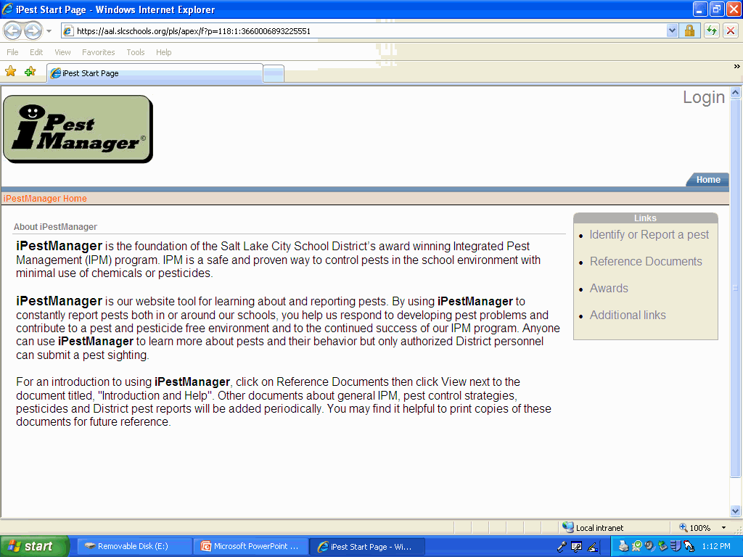
I Pest Manager

Slide 14
Written IPM Plan

Slide 15
Your Site IPM Binder.
What is this thing? and why do I need it?
To keep your IPM Records in
Provide a copy of the Written IPM Plan
Stay organized
To keep your Training Materials in
Monitoring Information
To retain helpful Pest Information

Slide 16
Training Responsibilities

Slide 17
Who Trains Who?
Head Custodian is responsible for the training of all of the custodians at their site.
Federal and State Agencies (EPA etc.)
District
Custodial Supervisors
Head Custodians
Night Supervisors
Sweepers

Slide 18
EPA What is its roll in IPM?
Training and enforcement

Slide 19
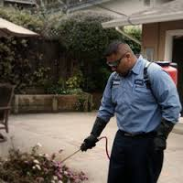
PMP
PEST MANAGEMENT PROFESSIONAL

Slide 20
Our preferred bug exterminator

Slide 21
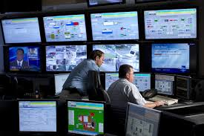
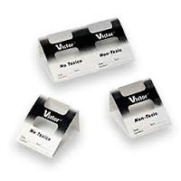
Monitoring
What is this sticky thing used for?
For Tin Cat mouse traps.
Monitoring
Catching some insects and spiders

Slide 22
Site Map

Slide 23
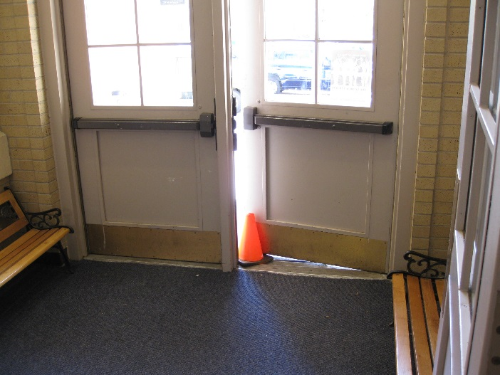
Daily Duties
Eyes open
Teach
Report

Slide 24
Now let’s meet some of our most common pests!

Slide 25
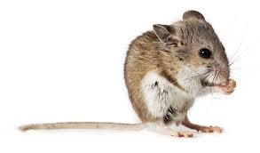
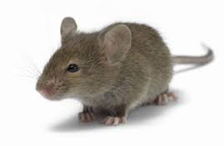
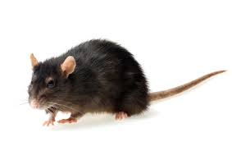
Mice and Rats
Deer Mouse
House Mouse
Norway Rat

Slide 26
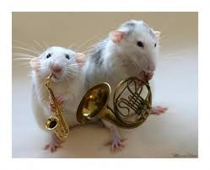
Mice facts
Will Urinate up to 1000 times a night!
Maybe more if they are over 40.
Can fit through a hole the size of a #2 pencil
Cannot play musical interments.

Slide 27
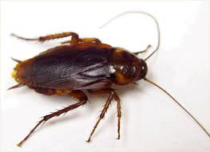
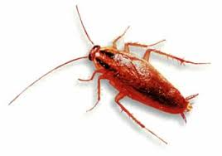
Cockroaches
Infesters and Non infesters
There are 2 main types in Utah.
Oriental Roach German Roach

Slide 28
German Cockroach
Smaller size
Lighter in color
Often brought in by others (Trespassers).
Infesters
Carry disease.

Slide 29
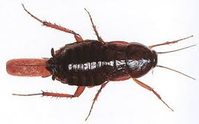
Oriental Cockroach
Larger in size
Darker in color
Not Infesters
Often found in or near drains.
Also carry disease.

Slide 30
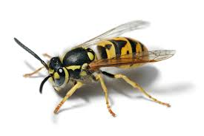
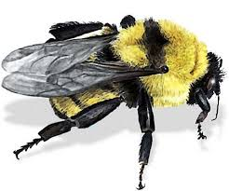
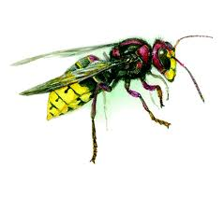
Wasps, Hornets and Bees
All not very active In cooler temperatures.
Bees feed on pollen and are very beneficial.
Wasps and Hornets are predatory.
Stingers are different.
Bees often look fuzzy.
Pollinators –vs- non pollinators.
Yellow Jacket Wasp Bumble Bee European Hornet

Slide 31
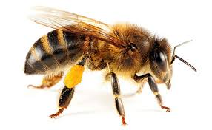
Bee, Wasp or Hornet?
Honey Bee

Slide 32
Bee, Wasp or Hornet?
Bald Face Hornet Wasp

Slide 33
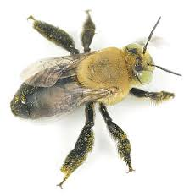
Bee, Wasp or Hornet?
Solitary Bee

Slide 34
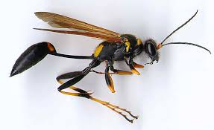
Bee or Wasp or Hornet?
Mud Dauber Wasp ( Feed on black Widow)

Slide 35
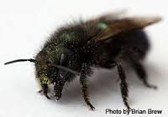
Bee, Wasp or Hornet?
Mason Bee

Slide 36
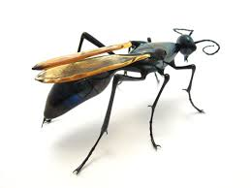
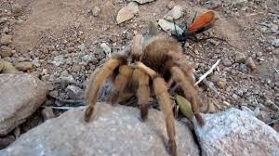
Bee, Wasp or Hornet?
Tarantula Hawk Wasp

Slide 37
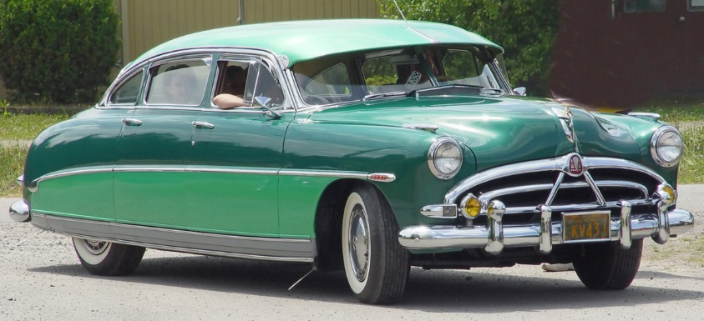
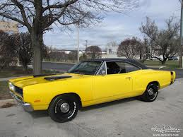
Bee, Wasp or Hornet?
Hudson Wasp
AMC Hornet
Dodge Charger, Super Bee

Slide 38
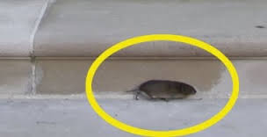
Pest Thresholds
Do we really need to kill every bug and mouse?
Well... It depends…

Slide 39
EXAM

Slide 40
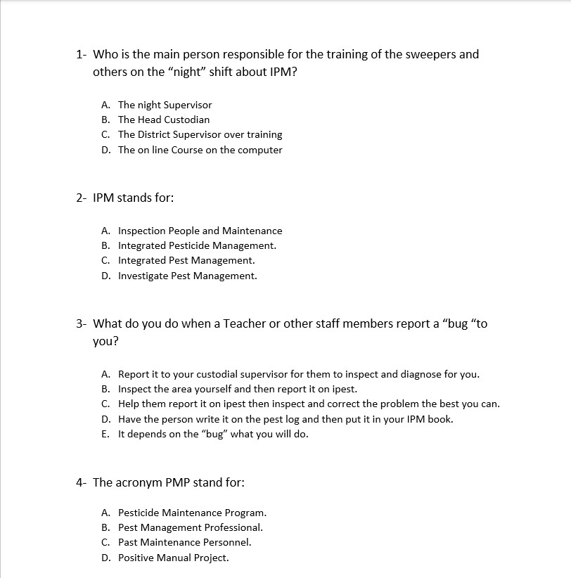

Slide 41
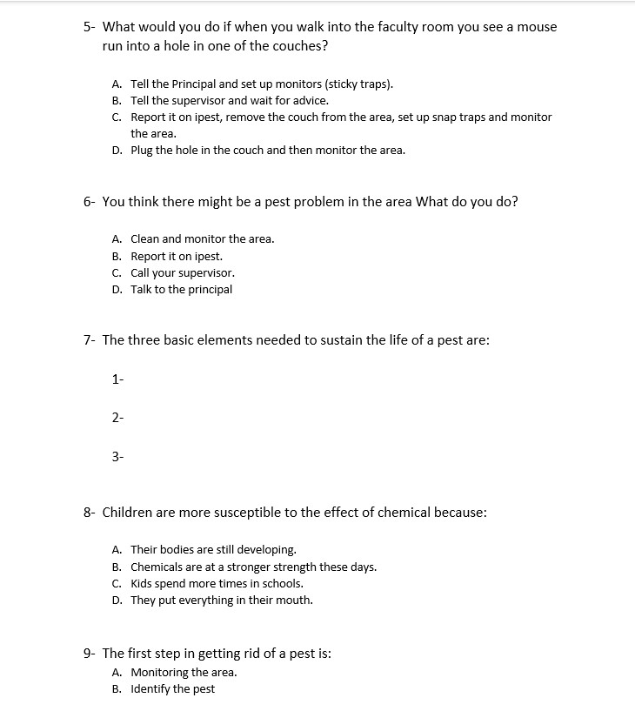
C. Report it on iPest
D. Set traps

Slide 43
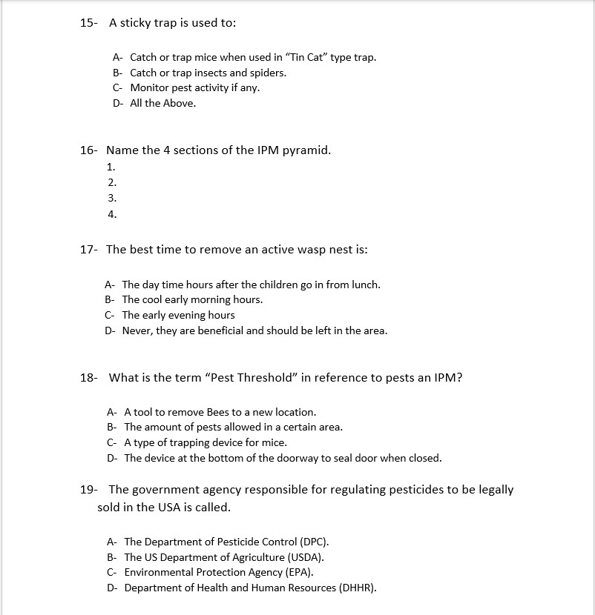

Slide 45
The End

