Slide 1
How West Allis – West Milwaukee School District is Using Healthy Green Schools & Colleges to Optimize Its Facilities Program

Slide 3
Program
Developed in partnership with school facility directors
Encourages continual improvement
Covers the full range of facilities management practices
STANDARD

Slide 4
Standard
Prioritizes low- and no-cost measures that make a significant different in indoor air quality
Designed to be implemented district-wide or university-wide

Slide 5
Standard Snapshot
Section | Possible Points
Getting Started | Required
Procurement of Facility Operations and Maintenance Products | 16
Facilities Operations and Maintenance | 40
Building Systems Operations and Maintenance | 20
Ongoing Monitoring, Evaluation and Training | 24
Total | 100

Slide 6
Certification
Level | Points
Gold | 85+
Silver | 75-84
Bronze | 60-74

Slide 7
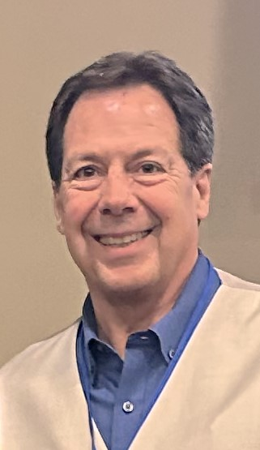
At a glance:
7,000+ students
18 schools
23 buildings
2,000,000 square feet
Steven Eichman
Facilities Manager

Slide 8
WAWM Assessment Results
Required Criteria Met: 5 of 10
Total Points Earned from Optional Criteria: 11 of 100
Projected Certification Tier: Not Yet Eligible for Certification
Section | Projected Score
Getting Started | 2 of 5 required criteria met
Procurement of Facility Operations and Maintenance Products | 3 of 3 required criteria met 6 of 16 possible points earned
Facilities Operations and Maintenance | 2 of 40 possible points earned
Building Systems Operations and Maintenance | 0 of 2 required criteria met 2 of 20 possible points
Ongoing Monitoring, Evaluation and Training | 1 of 24 possible points earned

Slide 9
WAWM’s Next Steps
Call Sara
Gather the team
Identify areas of focus
Get to work

Slide 10
Focus Area #1 – Consumable Goods
Met with distributor
Reviewed criteria for chemicals

Slide 11
Result
Reduced chemicals purchased from 30 to 8
Streamlined inventory system
Simplified and improved training
Created more flexibility

Slide 12
Focus Area #2 Powered Equipment
Met with distributor
Reviewed criteria for powered equipment
Used ESSR funds

Slide 13
Result
Purchased more than 60 pieces of equipment that meet standard

Slide 14
Focus Area #3 Connect with Other Schools
Summer summit
Cleanlink article
Fall Virtual Summit

Slide 15
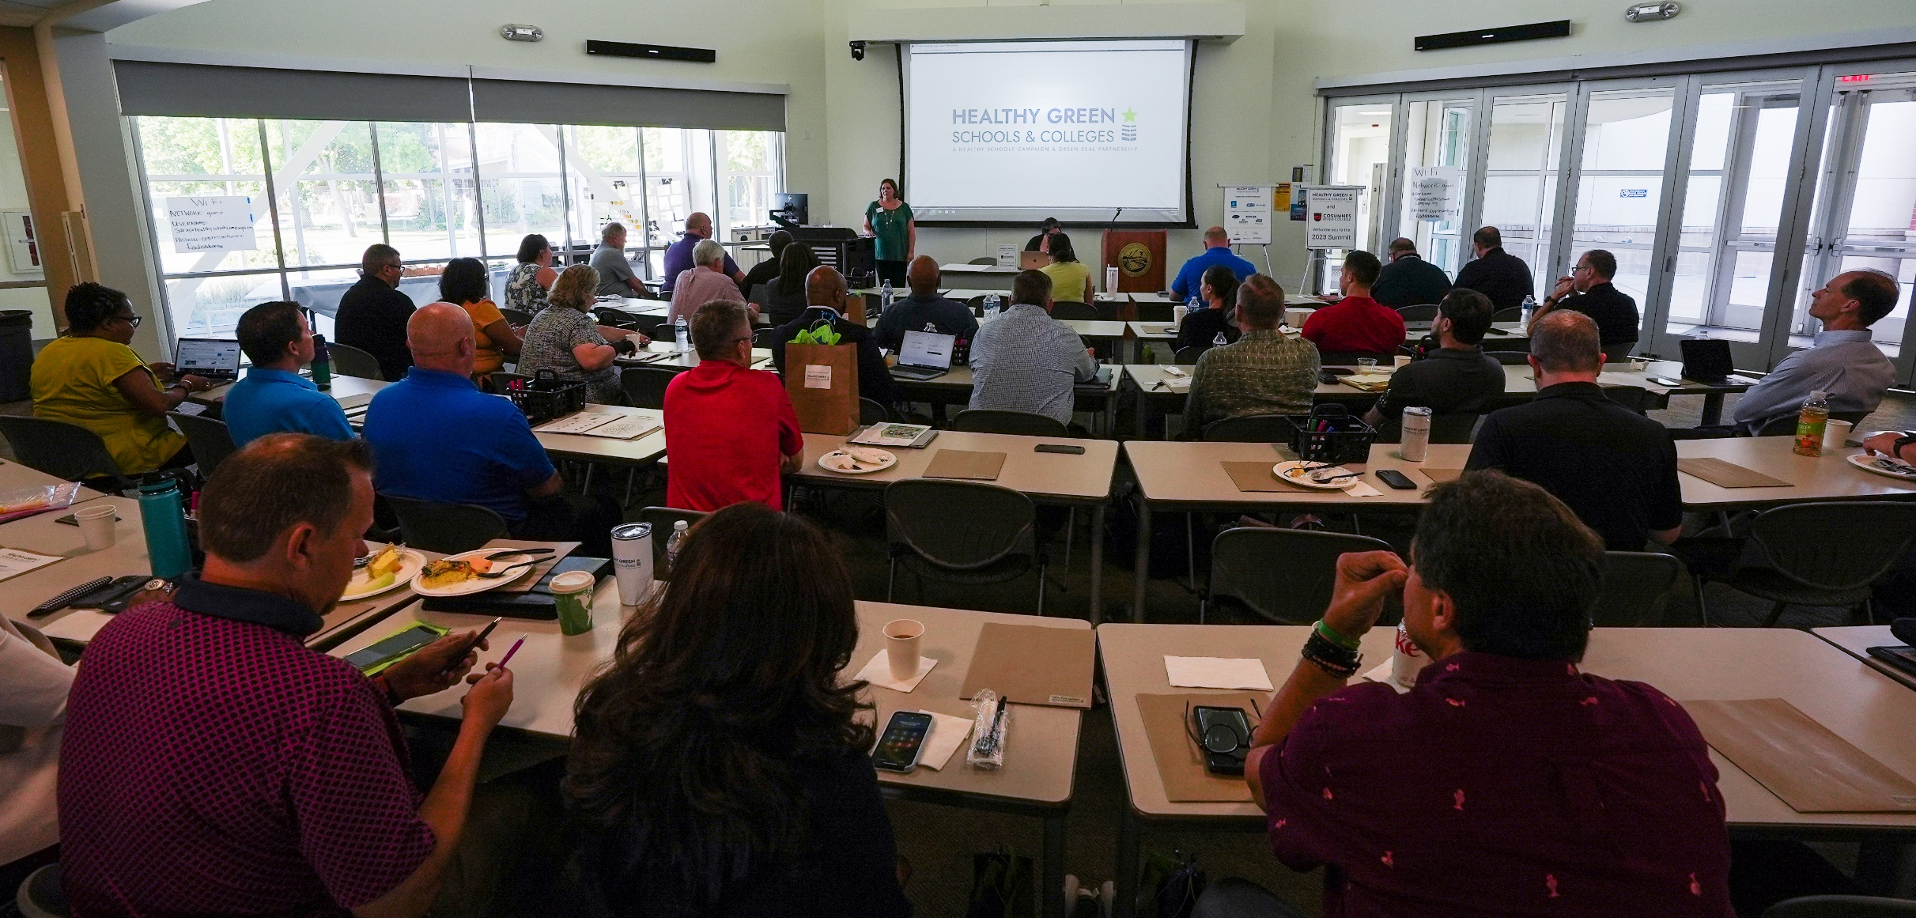

Slide 16
What Other Schools Are Doing
Making a case for budget allocation
Gathering team around a common goal – improving morale
Benchmarking/assessing
Getting recognized

