Slide 1
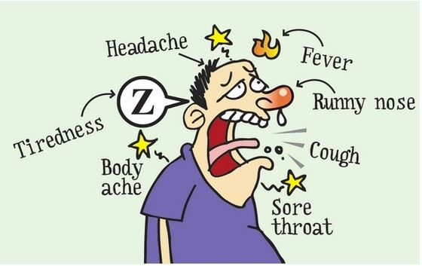
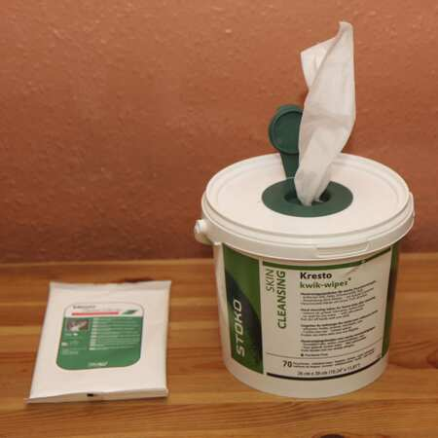
WIPES
Friend or Foe???????
VSPMA Richmond VA Oct 1, 2023 www.wilcoxevs.com

Slide 2
About Me!!!
Life long New Englander. Yes, I have the accent
Microbiologist & Engineer – Data, Data, proof of concept
25 years in the industry working with manufacturers, end users, state agencies, distributors, manufactures reps…..
“Green” less toxic chemicals expert, tech,
Process & procedures, training, education, reality in the work, systems, SOPs, marketing strategy…..
Look for truth in data, marketing and claims
Infection mitigation MUST HAPPEN!!!!! Public Health Issue
Technology is where this industry is headed, get onboard
Sustainability – what does it mean to you?

Slide 3
Subject Matter Expert
Green Cleaning & Infection Control Tech
Training to increase efficiency and work with new technology
Manuf proof of concept projects
Sustainability metrics
Electrostatic & fogging
Performance & Real world testing
Technical writing on these subjects
https://www.cleanlink.com/search.aspx?cof=FORID%3A9&cref=https%3A%2F%2Fwww.cleanlink.com%2FAnnotationCL.xml&q=wilcox

Slide 4
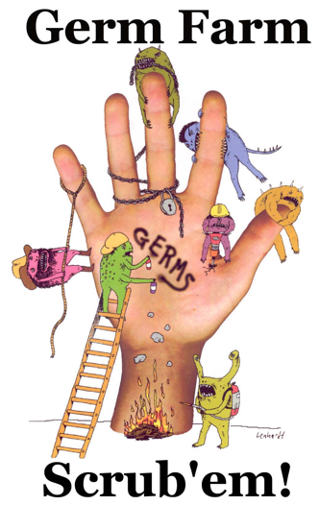
What We Will be Discussing Today
Wipes
Wipes
Wipes
When will Tom Brady Unretire
Wipes
Are all wipes made the same?
Do disinfecting wipes work?
Can they harm you?

Slide 5
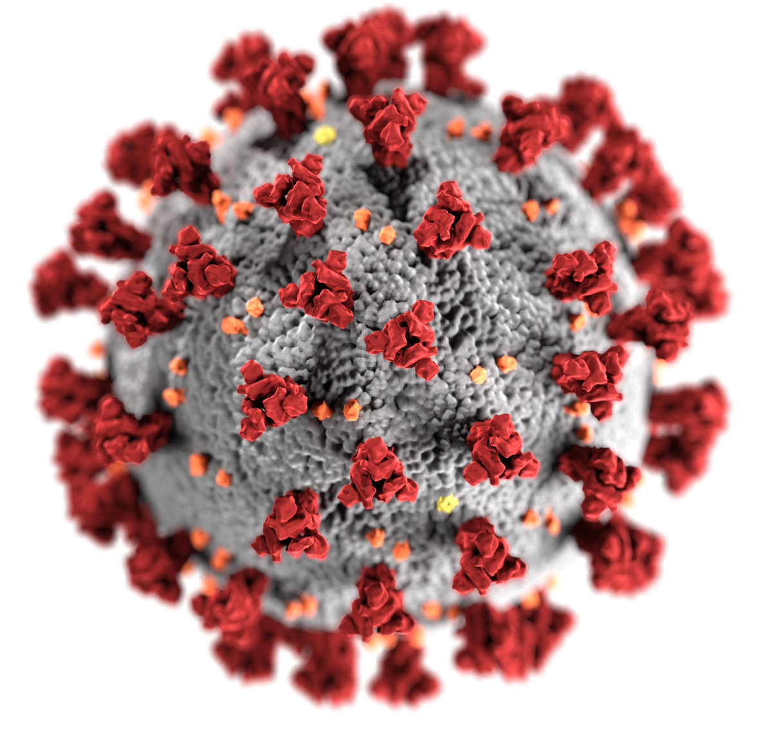
The Bug in the Room Still….Corona / Covid
Are there any questions I can answer about infectious diseases, vaccines etc. before we go on?
This year it is Cold, Flu, RSV, Covid and more season
Anything?
No bad questions?
I cant help you if I don’t know what your problems are our what you are doing

Slide 6
So What Germs Do You Encounter?
What do K–12 schools see during the school year?
Cold, flu, MRSA, Norovirus, Covid, RSV
Ok Ill ask some questions…..
Do you have to clean before you sanitize or disinfect?
Is one step ok?
Should you know what your active ingredients are?
Do you use wipes at your school? Home?
Which ones and why?

Slide 7
We Know per EPA, CDC & Industry Best Practices….
Use two step process
MUST clean BEFORE sanitizing and disinfecting
Remove soils where pathogens hide
Remove biofilm and food source
Removal less toxic than killing
Sanitizers and Disinfectants – EPA reg pesticides
Always hazards
Never chemical free
Never Nontoxic or Safe
Know your active ingredients – they aren’t all made the same

Slide 8
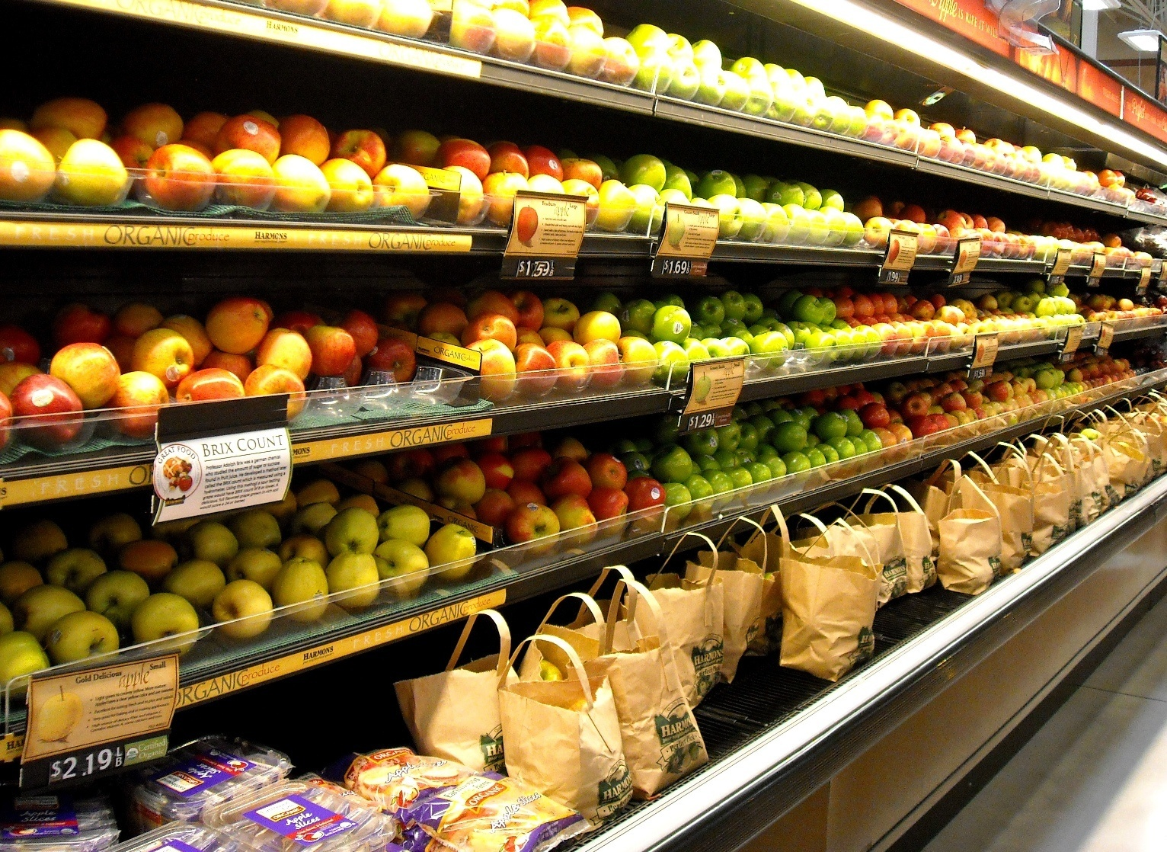
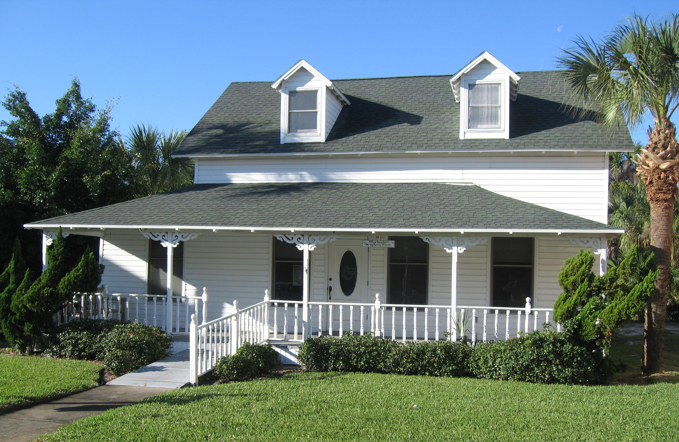
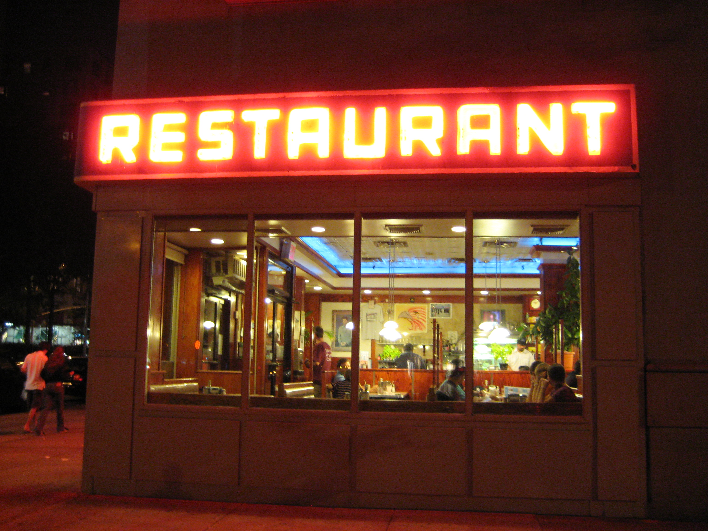
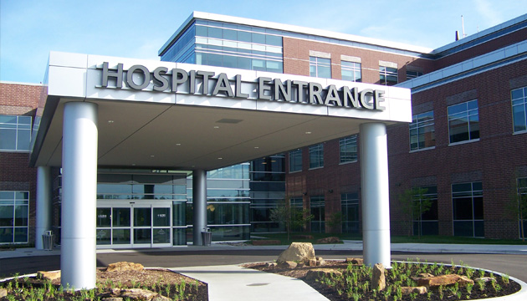
Green Cleaning & Infection Control Apply Everywhere, Especially Now
Schools, universities, daycares
Office buildings, airports,
Grocery stores, markets, restaurants
Buses, trains, cars
Homes, hotels, motels, B&Bs
Hospitals, assisted living
Apartment buildings
Every space in our lives

Slide 9
What wipes do you use?????
Safe space
No one is wrong
We will learn from each other
What type of wipes do you use?
General cleaning ones?
Lysol
Clorox
A more environmental brand?
Why do you like wipes?
SO they do what they say they do?

Slide 10
Do Disinfecting Wipes DO What They Say They Do
Probably not due to dwell time
What's the difference between Sanitize and disinfect?
What does dwell time mean?
What has to happen to have the right dwell time?
So, if we don’t have that what happens?

Slide 11
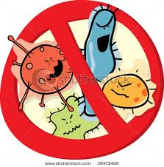
Disinfection / Sanitizing
Antimicrobial Pesticides – ALWAYS HAZARDS /TOXIC
HOCl least toxic compared to quats & chlorine bleach
Never non-toxic, least or less toxic
Never chemical free water is a chemical
Cleaning vs. Disinfecting & Sanitizing
Removal of soils & biologics – cleaning (up to 90%)
Disinfecting 90 percent of the last 10 percent
Sanitizer – lower concentration, shorter dwell time, 99.9
Disinfectant – higher conc., kills more, longer dwell time, 99.999
One product can be both sanitizer / disinfectant HOCl

Slide 12
Lets Compare Chemicals A, B & C – Pick one
EPA Registered Disinfectant Comparison Table
 | A | B | C
Asthmagen | Y* | Y^ | N
pH | 13 | 13 | 6.5-7
EPA Registered | Y | Y | Y
No Rinse Food Contact Sanitizer | N | N | Y
Causes eye, skin and resp system irritation | Y | Y | N
Fragrances & Dyes - synthetic | Y | Y | N
Can leave residue behind | Y | Y | N
Sustainable | N | N | Y
Biodegradable | N | N | Y
Can cause Superbug formation by the mode of killing microbes | Y | Y | N
Reproductive, neurological & Possible Parkinson | N | Y | N
* Can exacerbate respiratory issues
^ Can cause primary asthma with one exposure, AOEC list

Slide 13
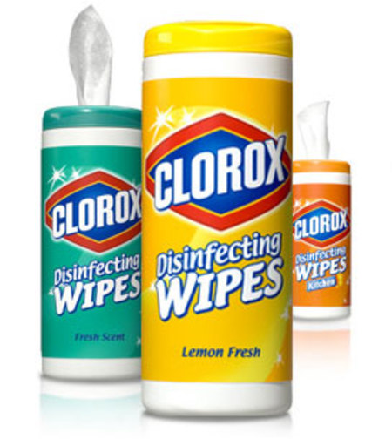
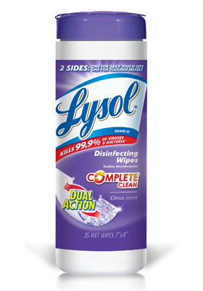
Why are Chlorine Bleach & Quats Bad?????
A = Chlorine Bleach – sodium hypochlorite –OCL
Clorox wipes
Caustic, high pH, causes burns, bleaches color
Not stable, once diluted only good for hours
Not diluted good for weeks only
Harmful to skin, eyes, lungs
B = Quaternary Ammonium Cmpds - N-Alkyl* dimethyl benzyl ammonium chloride
Lysol wipes
Causes asthma, can cause new cases
Caustic, bad for the env & animals (fish)
Harmful to skin, eyes, lungs

Slide 14
Chemical C – Hypochlorous acid
C -Hypochlorous Acid, HYPO, HOCl !!!!
The Holy Grail of Disinfectant!

Slide 15
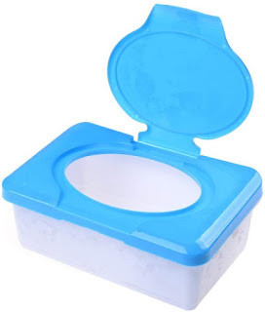
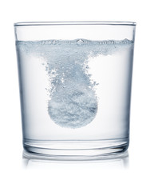
Can You Get Hypo Wipes?
Glad you asked
Yes or you can make some
I hear some companies have them, but I haven’t seen them, have you?
I'm working with a company now that has them and should be for sale soon – Toppen Home
You can make them. Everyone loves DIY
Buy dry wipes and add hypo to wet them
Get hypo by a machine or tablet
Tabs cheapest and easiest way
What concentrations – 500 best kill most things including covid

Slide 16
Know Your Disinfectant!
What is the active ingredient
What is its CAS#? It will be on the SDS
Look it up, its its fingerprint
Ask a friend (ME)
Ask yourself what do you want to kill, what active ingredients and then compare them
Always hazards with Sanitizers /Disinfectants – pesticides
NEVER NON-TOXIC – if someone tells you that RUN
Look at Efficacy or kill, cost, heath & safety & other attributes

Slide 17
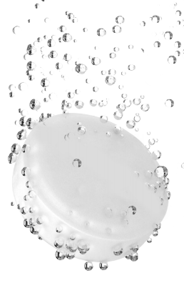
What is Hypochlorous acid, HOCl
The answer to toxic sanitizing and disinfecting
Can be made with a generator or tablet
Sanitizer and disinfectant, pH neutral
Can be used to kill food borne pathogens at low concentrations with no rinse needed, to killing C. diff in healthcare facilities at higher concentrations
Non synthetic, not fragrance or dyes added
Less caustic, does not bleach color out of materials
Kills a wide range of pathogens
Made in our own bodies and our immune system
Cost per gallon under 5 dollars
NaCL

Slide 18
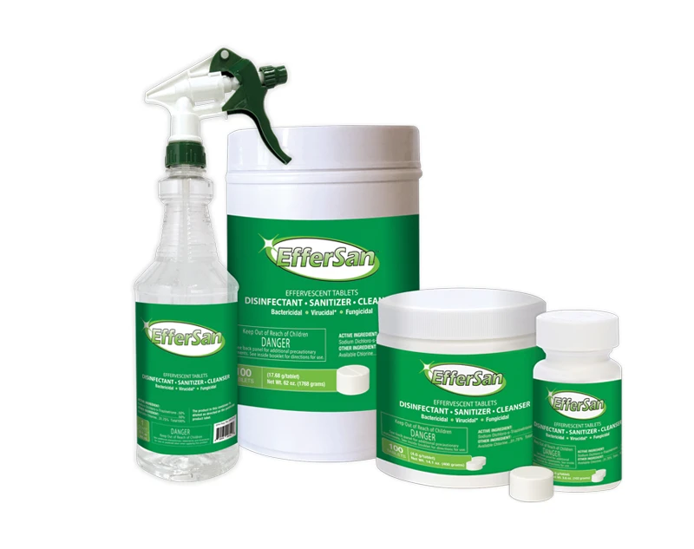
So Why is HOCl the Answer
The least toxic wide range sanitizer / disinfectant on the market
Neutral pH & does not bleach color at regular concentrations of use, 200, 500, 1000 ppm but color fast test
Cl based, cousin to chlorine bleach but the one that is liked in the family and invited to the cookout
Much more disinfection capability then chlorine bleach
We make it in our bodies, our immune system
Less toxic to humans, the environment & animals, almost no irritation & sensitizing diluted, less caustic, better materials computability – due to pH
Does not promote formation of superbugs

Slide 19
Hypochlorous Acid, HOCL, NaDCC Tablets
Why NaDCC tablets to make Hypochlorous?
Sustainable
Tablets inexpensive way to get into HOCl
Shelf stable as a tab for 3 years, sustainable, not shipping water, saves space
Stable in a closed container Can use it on food contact surfaces with no rinse up to and hospital rooms, C. Diff, depending on concentration
IT IS A DIRECT REPLACEMENT FOR CHLORINE BLEACH THAT WONT BLEACH!!!!
Try It!!!!!!!

Slide 20
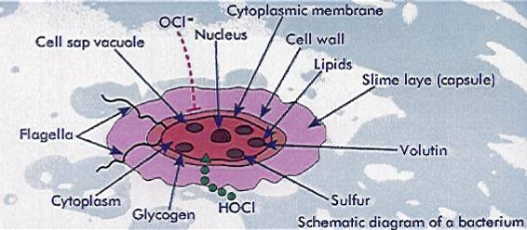
How HOCl Kills
Very much like water
Cell lets it in
When inside it breaks down the cell from the inside out
Bug never has a chance to know what is happening so doesn’t try to defend itself and adapt
This way superbugs are not formed

Slide 21
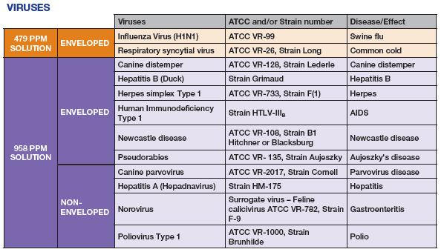
What HOCl Kills

Slide 22
How DO You Find Out About New Products
Do more than use what your vendors/ manuf are pushing
Read your trade magazines, Linked In
Talk to your peers
Get on the internet & research – CMM, Trade Press
Know the questions to ask, don’t believe the pretty brochure or video or website – ASK QUESTIONS
Ask for Proof, data, customers, references
Think outside the box, get help, make a case for change to your business office, superintendent, board, PTA

Slide 23
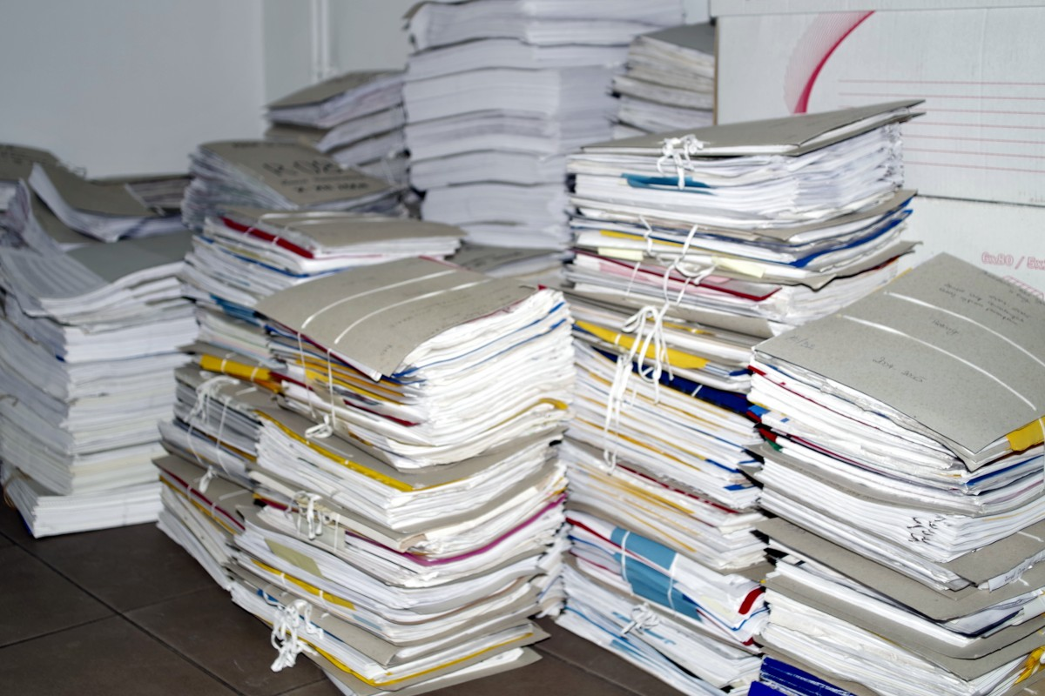
Questions to Ask About New Products
Why their product? What does it do that yours don’t do now
Ask to see data.
If it is going to save time, then see time studies
If it kills better then ask for testing data, the lab it was done at
Ask about asthma, biodegradability, synthetic chemicals, sustainability, dilution rate to compare costs
As for customer references to call
Ask for case studies done by third parties in the field
If they cant produce the data run

Slide 24
Now The Question to You Is…..
Questions and concerns still?
If there is a more sustainable, less toxic, cost efficient, non synthetic, neutral pH, no supply issue way to kill or disinfect then why not try it?

Slide 25
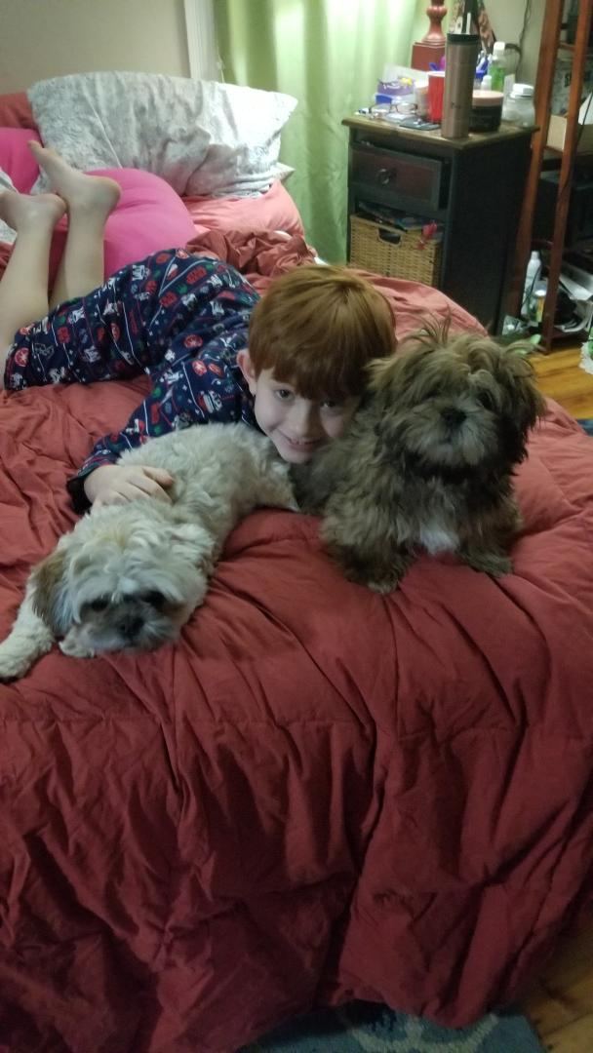
Thank You!! Questions?
Heidi Wilcox, M.Sc.
Wilcox PH / EVS Solutions
Heidi@wilcoxevs.com
www.wilcoxevs.com
781 640 6401

Slide 26
WIPES
Friend or Foe???????
VSPMA Richmond VA Oct 1, 2023 www.wilcoxevs.com

Slide 27
About Me!!!
Life long New Englander. Yes, I have the accent
Microbiologist & Engineer – Data, Data, proof of concept
25 years in the industry working with manufacturers, end users, state agencies, distributors, manufactures reps…..
“Green” less toxic chemicals expert, tech,
Process & procedures, training, education, reality in the work, systems, SOPs, marketing strategy…..
Look for truth in data, marketing and claims
Infection mitigation MUST HAPPEN!!!!! Public Health Issue
Technology is where this industry is headed, get onboard
Sustainability – what does it mean to you?

Slide 28
Subject Matter Expert
Green Cleaning & Infection Control Tech
Training to increase efficiency and work with new technology
Manuf proof of concept projects
Sustainability metrics
Electrostatic & fogging
Performance & Real world testing
Technical writing on these subjects
https://www.cleanlink.com/search.aspx?cof=FORID%3A9&cref=https%3A%2F%2Fwww.cleanlink.com%2FAnnotationCL.xml&q=wilcox

Slide 29
What We Will be Discussing Today
Wipes
Wipes
Wipes
When will Tom Brady Unretire
Wipes
Are all wipes made the same?
Do disinfecting wipes work
Can they harm me?
Cleaning & sanitizers / disinfectants can do harm depending on the active ingredient used

Slide 30
The Bug in the Room Still….Corona / Covid
Are there any questions I can answer about infectious diseases before we go on?
This year it is Cold, Flu, RSV, Covid and more season
Anything?
No bad questions?
If you participate, I may throw a prize at you
Seriously
I have stuff with me
Good stuff

Slide 31
So What Germs Do You Encounter?
What do K–12 schools see during the school year?
Cold, flu, MRSA, Norovirus, Covid, RSV
Ok Ill ask some questions…..
Do you have to clean before you sanitize or disinfect?
Is one step ok?
Should you know what your active ingredients are?
Do you use wipes at your school? Home?
Which ones and why?

