Slide 1

Virginia School Plant Management Association
( VSPMA) Presentation
SCAP - School Construction Assistance Program
SEGM - School Security Equipment
FY24 School Safety and Security Grant
SASI - Supporting America’s School Infrastructure
Literary Loans
M-R FIX - Maintenance Reserve Facility Indexing

Slide 2
School Construction Assistance Program (SCAP)
SCAP Overview
SCAP 2025-2
(second round)
SCAP Updates for 2025
Reimbursement Process for SCAP22 & SCAP FY24

Slide 3
SCAP Background Information
The School Construction Assistance Program (SCAP)
Created during the 2022 Special Session I of the General Assembly through the 2022 Appropriation Act (Chapter 2, Item 137, Paragraph C.43). Item 137, Paragraph C.43)
$80.0 million in funding for the School Construction Assistance Program was continued for the 2024-2026 biennium at the 2024 Special Session I of the General Assembly through the 2024 Appropriation Act (Chapter 2, Item 125, Paragraph C.42)
During the 2025 General Assembly session and additional $120.0 million in funding was appropriated for FY 2025 plus an additional $50.0 million is to be transferred from the Literary Fund resulting in an additional $170.0 million to be awarded in fall of 2025. Also $30.0 million was added to SCAP 2026.
  42. School Construction Assistance Program.
    Out of this appropriation, $80,000,000 the first year and $80,000,000 the second year from the School Construction Fund is provided for the Board of Education to award grants on a competitive basis from the Fund to local school boards that demonstrate poor building conditions, commitment, and need in order for such local school boards to fund the construction, expansion, or modernization of public school buildings. Any unobligated balance for this program on June 30, each year shall be reappropriated for expenditure in the second year for the same purpose.

Slide 4
SCAP Background Information
The School Construction Assistance Program for FY25 (SCAP25)
Grants awarded are based on 10%, 20%, or 30% of approved project costs, determined by the school division’s local composite index and fiscal stress category.
Additional funding was added to the SCAP Grant Program for 2025 and 2026. A second application period should be opened in October 2025 for the additional $170,000,000 in funding allocated for SCAP 25-2.
SCAP 26 will be open for application in the spring of 2026 with $110,000,000 in available funding.
The recently amended Guidelines for SCAP FY25-26 were approved by the Board of Education at the September 25, 2025 meeting.

Slide 5
SCAP FY25 Information
New this Year for SCAP 25.2
Amended 2024-2026 Guidelines
  Amended Guidelines for Implementing the School Construction Assistance Program in the 2024-2026 Biennium
Additional points will be awarded to schools, school divisions, and Regional CTE centers that have not been funded in the past 2 fiscal years.
Up to 3 school project applications may be submitted by a school division or regional CTE program governing board.
All CTE programs are eligible for extra points if they meet criteria outlined in the Guidelines.
Projects at multiple schools for the similar equipment replacement (for example: new windows or HVAC systems at multiple schools in the division) are eligible for grant funding.

Slide 6
SCAP FY25 Information
Grants are based on a percentage of approved project costs
  Minimum project cost of $500,000 for an individual project.
  Minimum project cost of $1,000,000 for a multi-school project.
  Maximum project cost $100.0 million.
A change in project scope after the grant is awarded may result in grant funding being rescinded and funds awarded to the next eligible application. Transfer of the awarded grant funds to another project within the school division is not allowable.
Awarded divisions will report the status of the awarded projects every 6 months.
Awarded school must be scheduled to remain open for at least five more years.
All projects must be submitted in SBCR application in the SSWS portal.
Awarded divisions must certify its intent to obligate awarded grant funds for the construction project within six months of the grant award.

Slide 7
SCAP FY22-25 Updates
  SCAP FY22
  Total Awarded Funds: $365,344,910
  28 Divisions Awarded (65 Applications)
  40 Projects Awarded
  Reimbursements are on going
  SCAP FY24
  Total Awarded Funds: $84,655,090
  18 Divisions Awarded (89 Applications)
  20 Projects Awarded
  SCAP FY25
  Final Chapter 725, adopted May 2, 2025, Appropriated $250 Million:
  First round of awards : $80 Million
    11 Divisions Awarded
  Additional $170 Million additional funds for another application round (these funds can be carried over into FY26).
    Applications will be open before the end of 2025.
  SCAP FY26
  Funds Appropriated: $110 Million

Slide 8
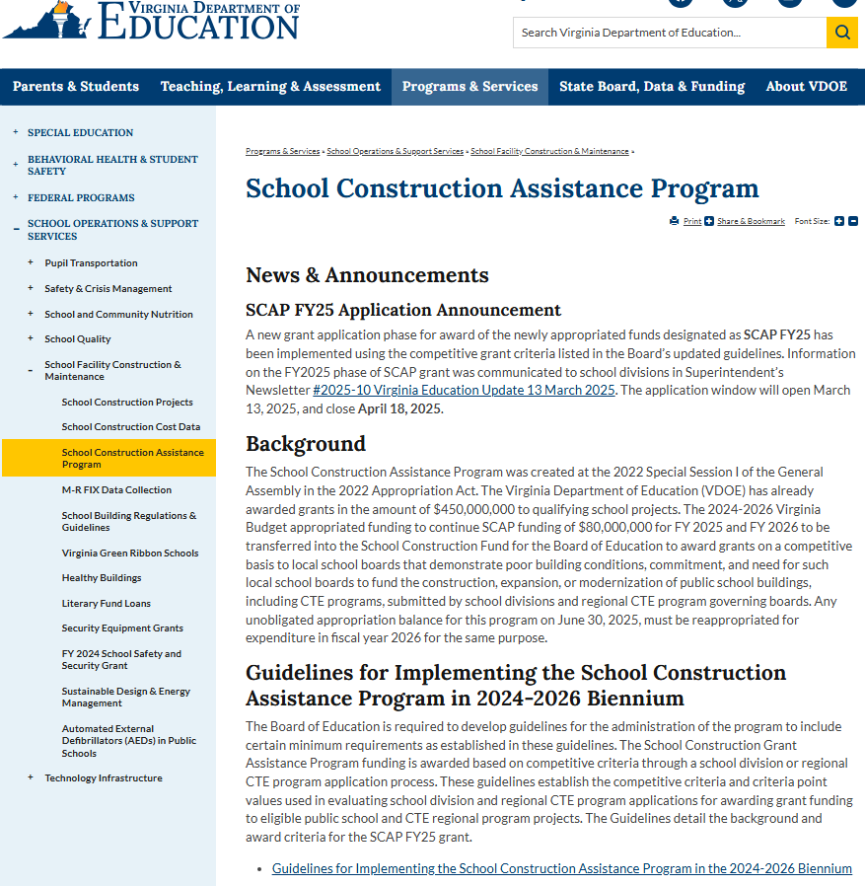
SCAP FY25 Information
Where can I find information on the School Construction Assistance Program Grant?
SCAP found in the Programs and Services tab
Applications for 2nd round of SCAP 25 open in mid Oct.
Applications for 1st round of SCAP 25 closed April 18, 2025
Past Grant Year Awards are located on our webpage
SCAP FY25.2 Information Updated in Superintendents Newsletter dated 13 March 2025
New SCAP application information will be communicated in an upcoming Superintendents Newsletter
SCAP Subtab
SCAP 2024-2026 amended Guidelines

Slide 9
SCAP Reimbursement (Found in SSWS/SCAP)
SCAP Reimbursement Request Instructions
Log into SSWS
Select SCAP application
Select Division
Select Reimbursement Request
Select Award Year from drop down list
Select School from drop down list
Enter reimbursement Amount Requested
  (no dollar sign ($) or commas (,)
Reimbursement forms located on website and in SSWS
Quarterly Reimbursement Dates (for all grant years):
Confirm request amount
    Jun 1
    September 1
  December 1
  March 1
This is a change.

Slide 10
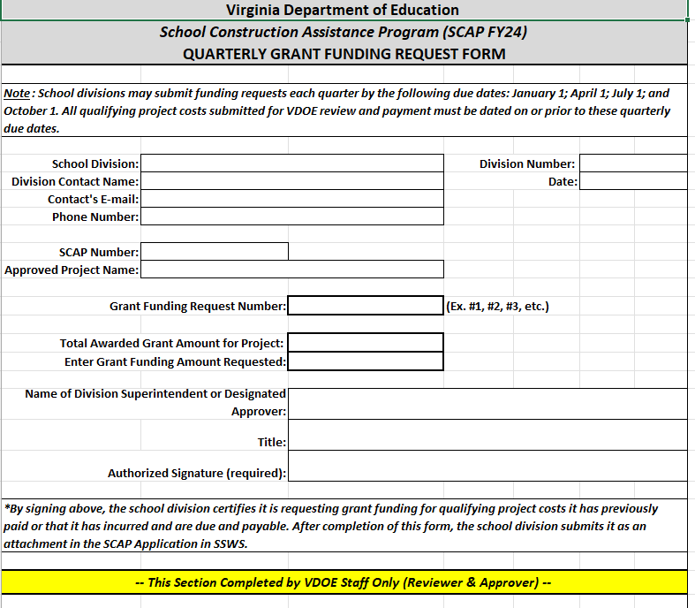
Reimbursement Forms
(found in SSWS/SCAP)
Confirm Correct Grant Year
Forms located in SSWS and webpage
SCAP # = SCAP(award year) - division #
(Example: Accomack’s number is SCAP22-001)
Double check your requested amount. If numbers don’t match the invoices, the request will be returned.
Confirm signature is included.
All required supporting documents are uploaded with application in one file, including the reimbursement form.
Reimbursements processed quarterly
SCAP Number
SCAP(year)-Div. #
Division #
& Request Date
SCAP2x-xxx
Requested Amount
Request #
Required Signature
Area to be completed by VDOE staff

Slide 12
School Security Equipment Grant
(SEGM)
Reimbursement Process
Frequently Asked Questions

Slide 13
SEGM Background Information
The Virginia Public School Authority (VPSA) issues equipment notes in conjunction with the existing Virginia Public School Authority technology notes program.
The 2025-2026 school year grants were awarded on a competitive basis, with each awarded school divisions eligible to receive grant awards up to $250,000.
$12 million in School Security Equipment Grants to help protect students, faculty and staff, and visitors.
  Awarded to 99 school divisions
  Awarded to 433 schools

Slide 14
SEGM Background Information
Eligible Equipment is listed in the application and on the VDOE webpage.
Funds are awarded based on a rank ordering of applications’ point total on the (10) competitive application criteria.
The criteria developed by VDOE and the Virginia Department of Criminal Justice Services gives priority to:
  Schools most in need of modern security equipment,
  Schools with relatively high numbers of offenses,
  Schools with equipment needs identified by a school security audit, and
  Schools in divisions least able to afford security upgrades.

Slide 15
Common Items NOT Eligible
(but often included) for Reimbursement
    Architectural / Engineering / other professional fees
    Repairs to existing security items (cameras, doors, intercoms, etc.)
    Tools or rental equipment
    Office or Storage Room door hardware (Classroom door hardware only)
    Exterior and Interior Doors
    Site work
    Light poles
    Relocating cameras or other security equipment
    Software license subscription, renewals, and insurance
    Stand alone software
    Apps
    Maintenance projects
    Door Hardware Items NOT ELIGIBLE:
      Doors.
      Door Closers
      Panic rim hardware devices
      ADA door levers
      Floor door barricade systems
      Mid-mounted door barricade systems
      Door closer barricade systems

Slide 16
School Bus Equipment
Security door hardware, or electronic card access reader systems for student ID verification at main entrances, other points of entry into the school building, and on school buses
Security related devices located inside school buses (interior security cameras, two-way talk radios) that serve bus routes for the school listed in this application
G.P.S. tablets to facilitate school bus routing, communications with school buses, and school bus and student tracking

Slide 17
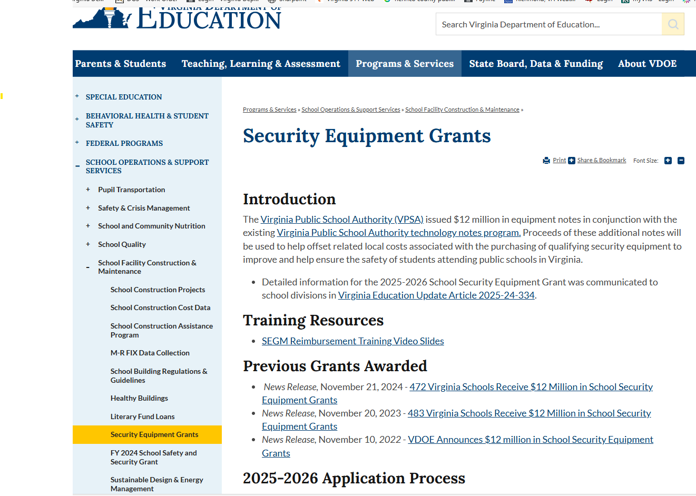
SEGM Information
Where can I find information on the Security Equipment Grant?
SEGM found in the Programs & Services tab
2025-2026 SEGM Information Updated in Superintendents Newsletter
Applications were due on August 1, 2025.
Reimbursements must be submitted by June 30, 2026
Past Grant Year Awards are located on our webpage
Reimbursement Forms are located at bottom of this page
SEGM Training Resources
SEGM Subtab
SEGM Previously Awarded

Slide 18
SEGM Reimbursement Forms
A Request for Reimbursement form must be completed and submitted to the Office of Support Services showing:
  school name,
  total cost of the qualifying equipment purchased,
  installation cost, and
  Include supporting documents showing the expenses incurred.
Awarded grant funds will be maintained and disbursed from accounts administered by the State Non-Arbitrage Program (SNAP) under VPSA.
Purchases of security equipment must be made within six months of notification.

Slide 19
SEGM Reimbursement Forms
SEGM Grant Year
Be sure to use the correct grant year form.
List of Eligible Items can be found on the reimbursement form
found on the reimbursement
form.
Forms for all years are on located on the VDOE the webpage
Include all supporting documents.
Submit reimbursement request by email to:
  supportservices@doe.virginia.gov or through SSWS Dropbox
Eligible Items

Slide 21
FY 2024 School Safety and Security Grant
Grant Overview

Slide 22
FY24 School Safety & Security Grant
Background Information
The final FY 2024 state budget includes $18.5 million in state and federal funding for the FY 2024 School Safety and Security Grants for public schools statewide. This is a one-time grant, and all school divisions were awarded funds.
The FY24 Grant is composed of both Federal & State Funding.
The FY24 grant funds to improve safety and security
of public schools can be used for:
  Equipment Purchases and Installations
  Software purchases
  Planning
  On-site Training
State Grant Deadlines:
Expenses beginning June 13, 2024
Complete Expenditures by June 30, 2025
Federal Grant Deadlines:
Must be obligated by December 31, 2024
Complete expenditures by December 31, 2025

Slide 23
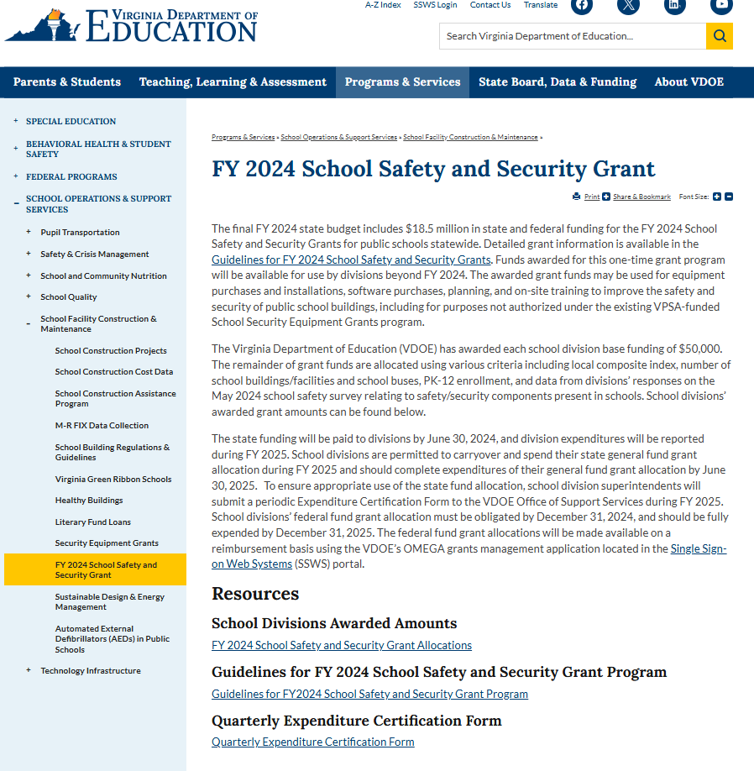
FY24 School Safety & Security Grant
Information
Where can I find information on the FY24 School Safety and Security Grant
FY2024 found in the Programs and Services tab
FY2024 Guidelines
Expenditure Certification Forms are located at bottom of this page
Federal Portion is reported in Omega in SSWS
FY2024 Grant
FY2024 Award Amounts
FY2024 Expenditure Forms

Slide 25
Supporting America’s School Infrastructure
(SASI)
SASI Grant Overview

Slide 26
Supporting America’s School Infrastructure
SASI Background Information
The Virginia Department of Education (VDOE) has been awarded a $5M competitive grant from the U.S. Department of Education’s Safe & Supportive Schools: Supporting America’s School Infrastructure (SASI) Grant Program ending in November 2028.
The purpose of this grant program is to increase the capacity of states in supporting high-need school districts and schools in leveraging available federal, state, and local resources to improve public school facilities, ensuring safe, healthy, sustainable, and quality learning environments.
Grant funds will allow the VDOE to:
  Conduct facility assessments and staff training in identified high-need school divisions.
  Development of a database and dashboard.
  Create a Virtual Building Condition Assessment tool for all school divisions.
  Assist divisions in developing their Capital Improvement Plans (CIP) and document funding needs to address facility improvements.

Slide 28
Literary Loans
Literary Loan Overview

Slide 29
Literary Fund Loans
Literary Loan Information
The Literary Fund is a permanent and perpetual school fund established in the Constitution of Virginia and the Code of Virginia to provide low-interest loans for school construction
The 2024 Special I General Assembly authorized from the Literary Fund for construction loans. Chapter 725 of the Budget provides:
  $200.0 million in FY 2025
  $50.0 million in FY 2026
Open application window period began in FY23:
  30 loan applications approved, and
  22 of those projects have had loans released by the BOE.
Loan approvals are not to exceed $25.0 million per project
Loan applications must meet the deadlines established by VDOE for consideration by the Board of Education.
Pursuant to 8VAC20-100-60 of the Virginia Administrative Code, the Board of Education will not approve a Literary Fund loan if the project has already been publicly bid prior to receipt of the application by VDOE.
Guidelines for eligibility are available on the VDOE website.

Slide 31
Maintenance Reserve Facility Indexing
(M-R FIX)
M-R FIX Overview
M-R FIX Templates

Slide 32
M-R FIX Background Information
M-R FIX - Maintenance Reserve Tool
Created in 2022 by the General Assembly,
Code of Virginia §22.1-138.3
The program initiated in 2023.
  § 22.1-138.3. Department; school division maintenance reserve tool
  A. The Department, in consultation with the Department of General Services, shall develop or adopt and maintain a data collection tool to assist each school board to determine the relative age of each public school building in the local school division and the amount of maintenance reserve funds that are necessary to restore each such building.
  B. Each school board shall provide to the Department in a timely fashion the local data that is necessary to ensure that the tool maintained pursuant to subsection A remains relevant and useful for the determination of maintenance reserve needs.

Slide 33
M-R FIX Background Information
DGS Template System
The Virginia Department of Education (VDOE) and the Department of General Services (DGS) work together using the DGS Real Estate and Assets Management System to gather the required school facility age and condition data for all existing facilities that serve an educational function.
This data is collected on one Excel file. There are two sheets in each file.
  Sheet 1: SITES
    Data collection for site information and infrastructure
    Site Records and Site Infrastructure Systems
  Sheet 2: BUILDINGS
    Data collection for building information and infrastructure, construction type, building condition, and use of spaces
    Building Records and Building Systems

Slide 34
M-R FIX
Why submit the data?
The legislature requires collection of data from all divisions across the state to determine the condition of all public schools in Virginia.
The M-R FIX tool calculates relative age of facilities:
  This may help estimate the maintenance reserve fund needed to maintain safe, adequate schools for Virginia’s students, and
  Help identify and prioritize facility needs.

Slide 35
VDOE Contact Information
OFFICE OF SUPPORT SERVICES
804-750-8715
supportservices@doe.virginia.gov

Slide 36
Questions?

